Slide 1
CMPUT 206: Wavelets and Multi-resolution Processing
Nilanjan Ray
Materials prepared from books by: (1) J.S. Walker, (2) Y.Y. Tang, (3) Gonzales & Woods

Slide 2
Agenda
In this lecture we will talk 1D signals; in the next lecture we will bring in 2D signals, i.e., images
To make everyone’s life simple, we begin with Haar wavelet transfrom; we will then understand wavelets!
We will talk about two applications of wavelets, eventually
Image compression
Image fusion

Slide 3
Haar Wavelet Transform
f is a 1D signal of length N = 2^{n}
Haar wavelet transforms f into two sub-signals of half lengths
First half is called trend: a¹ = (a₁, a₂,…,a_{N/2})
Second half is called difference : d¹ = (d₁, d₂,…,d_{N/2})

Slide 4
Haar Transform: Example
Example: f = (4, 6, 10, 12, 8, 6, 5, 5)
In symbol:

Slide 5
Inverse Haar Transform

Slide 6
Multi-level Haar Transform
2-level Haar transform:
3-level Haar transform:

Slide 7
Haar Transform: Example
A signal and its Haar transform (level 1)
A signal and its Haar transform (level 2)
This recursive transformation can go on!
How is the signal getting transformed by Haar ?

Slide 8
Conservation of Energy in Haar Transform
Let us define energy in a signal as:
Haar transform preserves signal energy:
Check this for the example: f = (4, 6, 10, 12, 8, 6, 5, 5)
Energy preservation explains the factor sqrt (2) in Haar

Slide 9
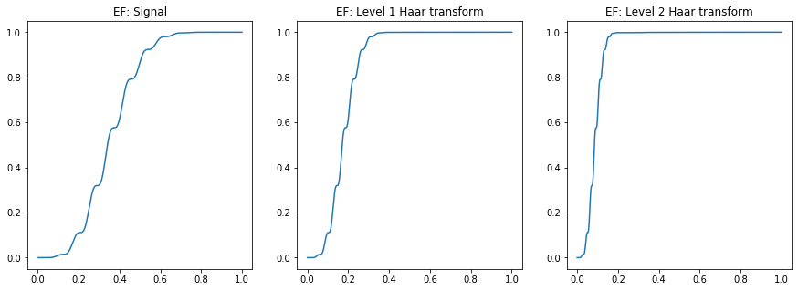
Conservation of Energy: Example
Energy compaction!
Rationale for signal compression using wavelet transform

Slide 10
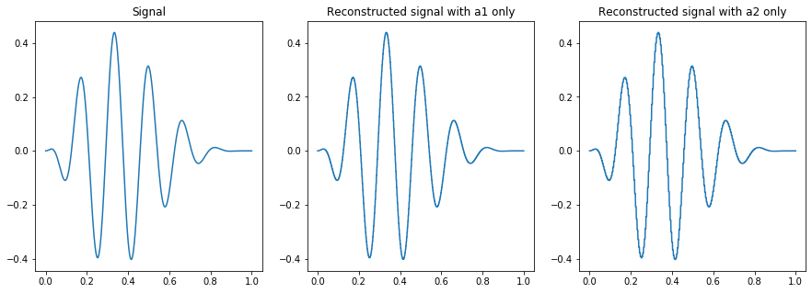
Inverse Haar Transform and Reconstruction
Can we zero out detailed coefficients and still reconstruct the signal well?
With 50% storage, we can preserve 99.97% of signal energy for this signal
With 25% storage, we can preserve 99.97% of signal energy for this signal

Slide 11
So, what is a wavelet?
We have looked at Haar transform, let’s know try to characterize wavelets
A wave
A wavelet
Wavelets, informally: (1) It is oscillatory in nature (wave)
(2) It has a short time span (short duration)

Slide 12
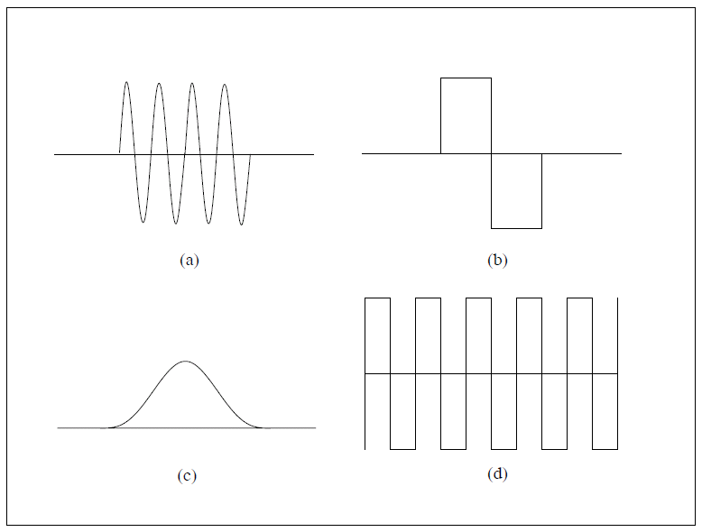
Wavelets, or not?
(a) and (b) are wavelets (c) and (d) are not. Why?

Slide 13
Haar Wavelets
Haar wavelets:
Wavelet transform coefficients:
etc.
where

Slide 14
Haar Scalings
Haar scalings:
Haar scaling coefficients:

Slide 15
Level 2 Haar Wavelets and Scalings

Slide 16
Other Wavelets
There are various other wavelets. Some examples:
Daubechies, Coiflet, Morlet, Mallat,…
Use PyWavelets
Daubechis 4/4 Wavelet

Slide 17
Applications of Wavelet Transform
Numerical analysis: solving differential equations
Compression
De-noising
Fusion
Feature detection
Texture classification
Recognition: speaker from audio signal, object from image, motion from video, fingerprint from image,…

Slide 18
Online Demo
http://rafat.github.io/wavelib/#/

